Slide 1
BIRLA VISHVAKARMA MAHAVIDYALAYA (Engineering College) (An Autonomous Institution) Information Technology Department AY: 2022 -23 4IT31 – Project I
Crypto blockchain transaction
Guide: Group Members:
PROF. Vishal polara Avlani hardish (19IT65)
Sanket Detroja (19IT413)
smit bhansali (19IT467)
Prince sheth (19It468)

Slide 2
Outline of the presentation
Objective
Scope
Introduction
Literature Survey
Class diagram/Activity diagram/Use-case diagram/Sequence diagram
Description of Modules & Functionalities
Results/Screenshots
Demonstration

Slide 3
OBJECTIVE
It will enable users to perform a quick Ethereum transaction.
It is a highly secure, quick, and reliable transaction platform.
It will ensure a security method for the transaction will not be compromised.
It provides all necessities like news, market, converter, and FAQ to perform a safe transaction.

Slide 4
SCOPE
Transparent transaction using blockchain technology increases the security of the transaction of crypto that races towards the cybersecurity.
All the data is secure and verified.
The encryption is done through cryptography to eliminate vulnerabilities such as unauthorized data tampering and this will increase the crypto payments.

Slide 5
INTRODUCTION
Blockchain is an element of technology used most notably in Cryptocurrency trading.
In recent times, Blockchain has received extensive attention in digital transaction and trading, and the top of that, it provides more security and transparency of transaction records.
With the help of Blockchain technology, we can make transactions in a decentralized manner with no involvement of any third-party system.

Slide 6
In this project, we have utilized Web 3.0, the latest internet technology that is helpful in Blockchain to achieve real-world human communication, and for transactions, we have used Solidity.
First, we have to connect our application to the MetaMask Wallet. Then we can send Ethereum from one account to another using the hexadecimal address of the wallet.
Here, we also have to send a message and a unique keyword to generate a GIF for the transaction.

Slide 7
After that, these transactions can be seen in the transactions part of the page with the individual GIF, the receiver's address, message, date and time, etc.

Slide 8
LITERATURE SERVEY
Sr. No. | Literature Review
1. | Brain Armstrong, who is founders of Coinbase application. Coinbase supports more than 44000 digital assets. It also supports Multi-signature and two-factor authentication support. But in it’s disadvantages is, Only available on mobile and tablet devices(Except for chrome extension).
2. | Maxim Rasputin who is CEO of Trust Wallet Application. Trust Wallet supports a vast range of coins and tokens. It also earn interest on one of 12 different cryptos. And it built-in Web3.0 browser. But in it’s disadvantages, Educational resource on coins and tokens are limited.

Slide 9
Sr. No. | Literature Review
3. | Ian Rogers who is CEO of Ledger application. Ledger application can install up to 100 apps at same time. It can buy and sell crypto directly through the Ledger Live app. It verify all transactions with 2-button presses. It can also compatible with 50 other hardware wallets. And in it’s disadvantages, it is more expensive than it’s original entry-level wallet.
4. | Daniel Castagnoli who is CEO of Exodus application. Exodus Application supports over 225 crypto assets. It is compatible with Trezor One and Trezor T hardware wallets. Allows users to buy Bitcoin with Apple Pay. And in it’s disadvantages, it’s transaction fees on the in-wallet crypto exchange. And Lack of native 2-factor authentication may bother to users. It is not supported in multi-signature.

Slide 10
Sr. No. | Literature Review
5. | Ouriel Ohayon, Who is CEO of ZenGo application. ZenGo provides keyless security system assures there is no single point of failure. We can buy crypto with credit, debit, bank transfer and Apple pay. And in it’s disadvantages, it has no private key is a big source of contention for some traders. And not all feature available worldwide.

Slide 11
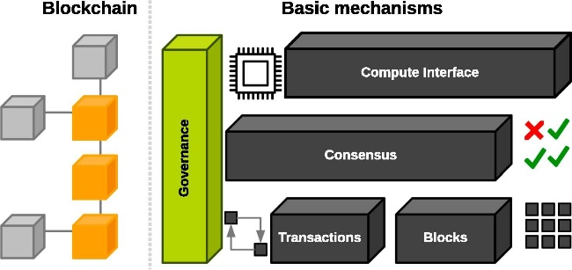
BLOCKCHAIN ARCHITECTURE

Slide 12
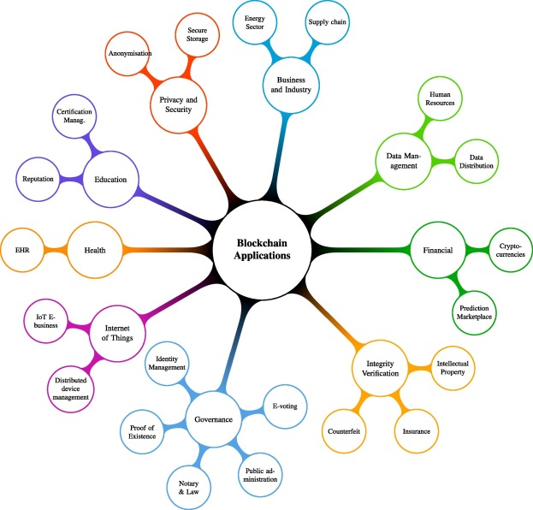

Slide 13
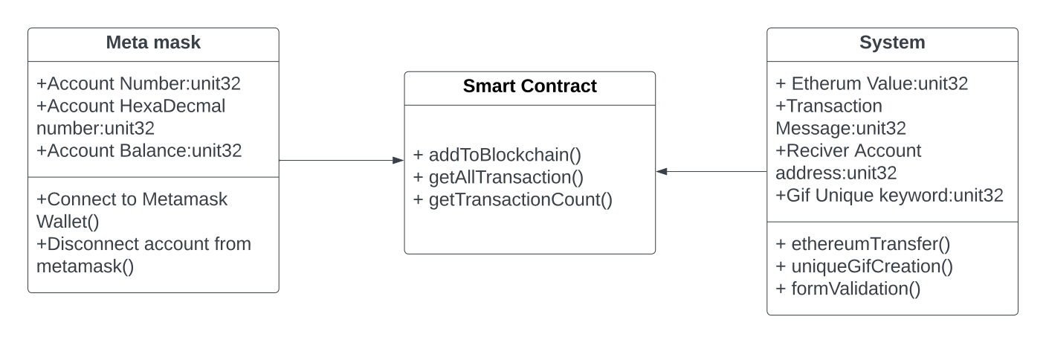
CLASS DIAGRAM

Slide 14
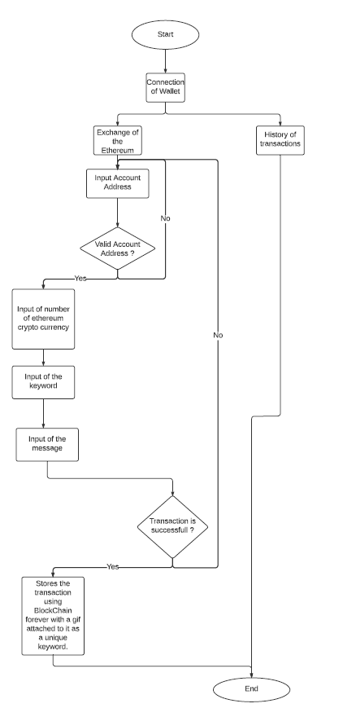
ACTIVITY DIAGRAM

Slide 15
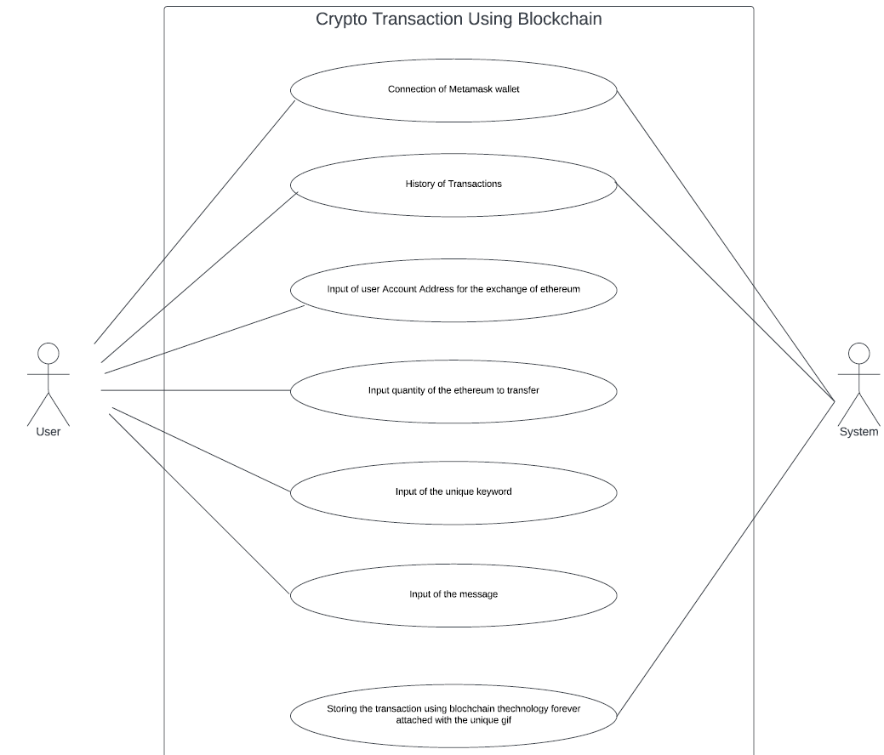
USE-CASE DIAGRAM

Slide 16
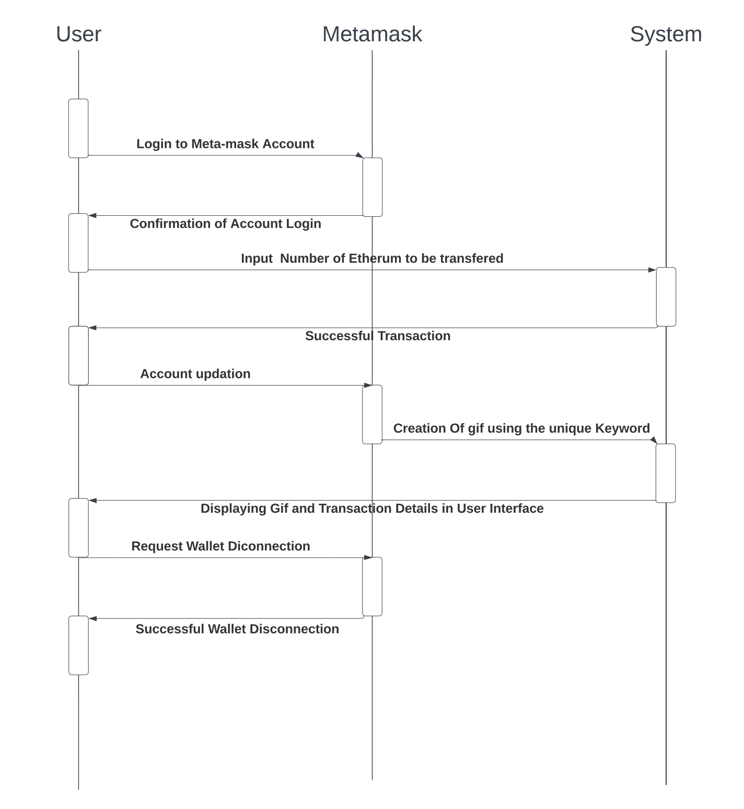
SEQUENCE DIAGRAM

Slide 17
MODULES AND FUNCTIONALITIES
1. Metamast Connection: Connection to metamask account using it’s web extension.
2. Transaction of crypto: After, connecting to metamask account user can do transaction to any account using reference of another account.
4. Transaction history: Shows user transaction in history.
3. Creating GIF: Each transaction has unique creation of GIF which will display as ID on website for transaction transparency.
5. Market news: User will stay updated with all crypto news that currently going on market.
6. Crypto Convertor: Creating convertor of crypto currencies from standard currencies.
7. FAQ: Learn basics blockchain technology from our UI.

Slide 18
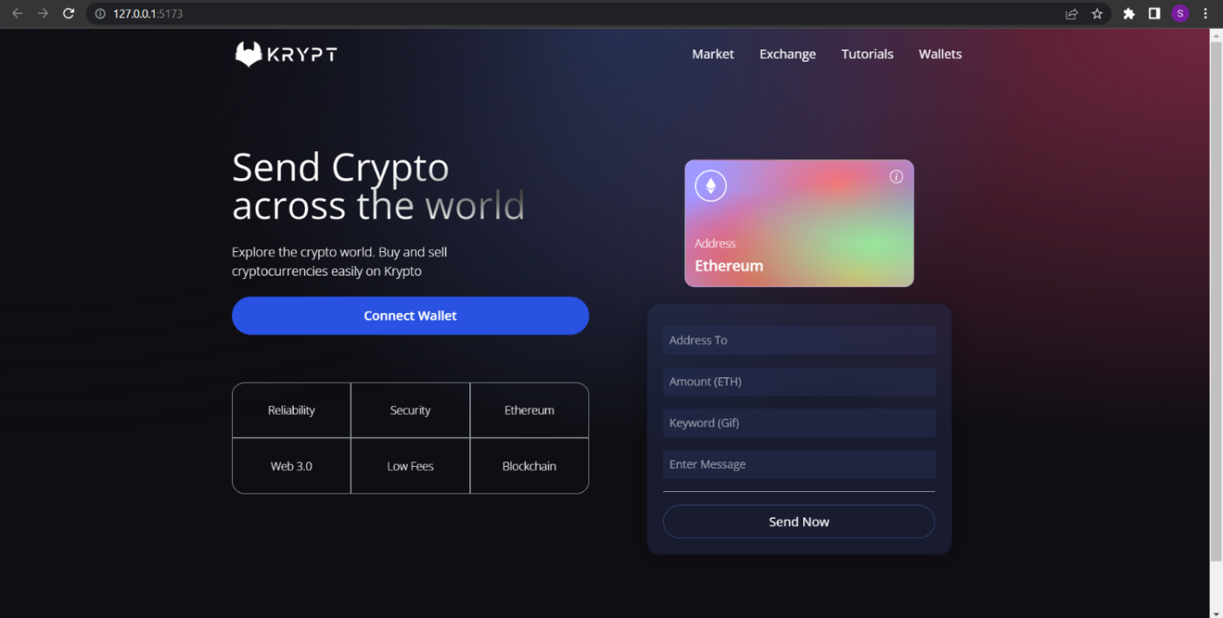
RESULT AND SCREENSHOT

Slide 19
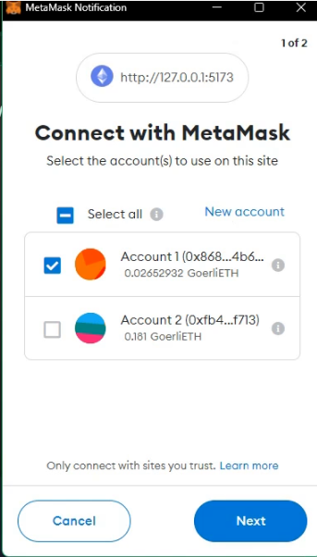
CONNECTION WITH METAMASK

Slide 20
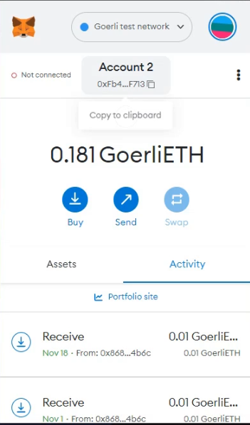
ACCOUNT OF USER

Slide 21
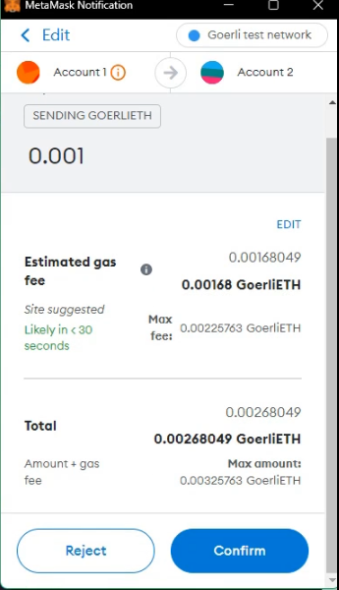
CONFORMATION

Slide 22
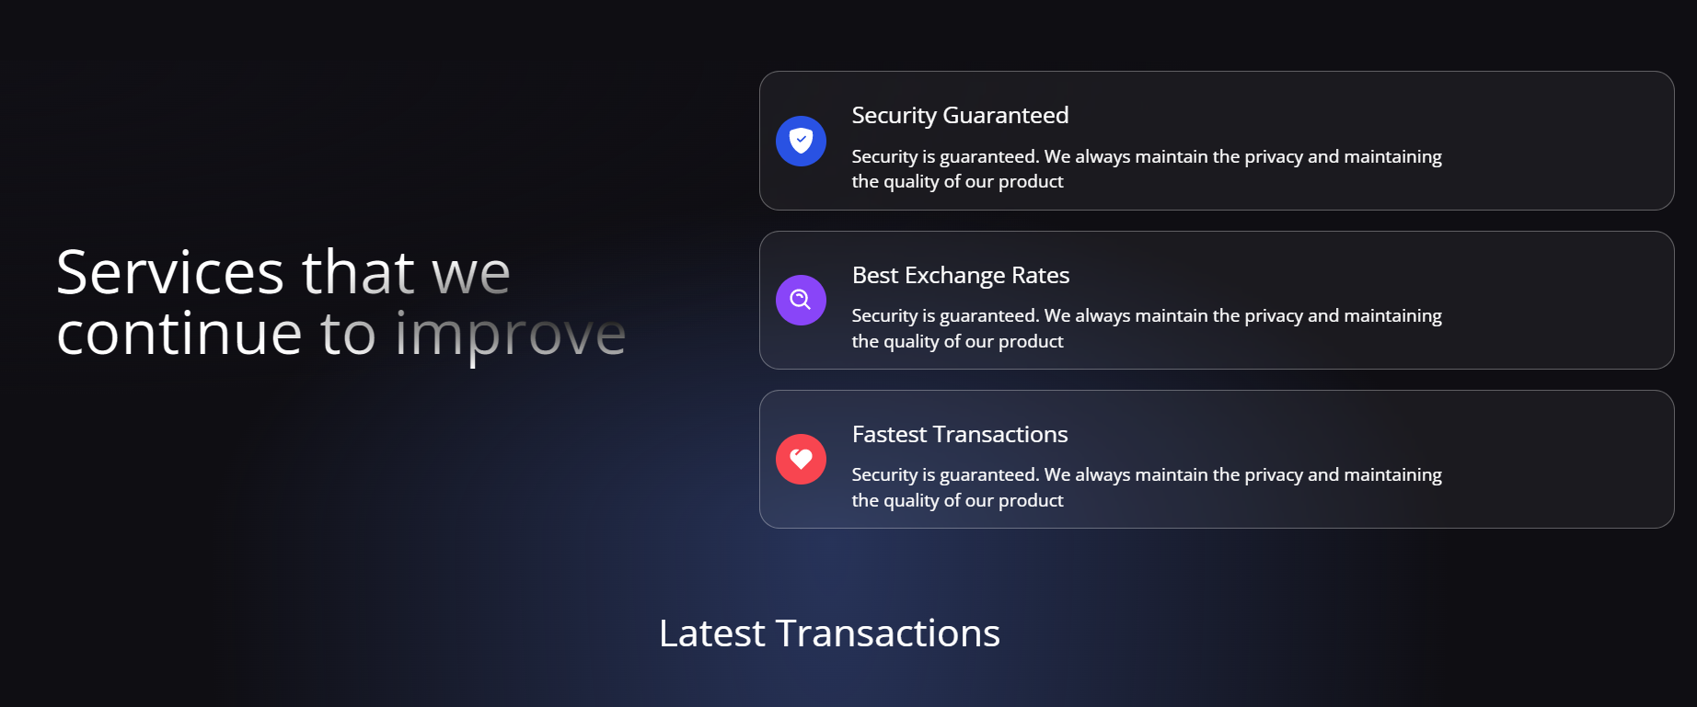
PLATFORM SERVIECES

Slide 23
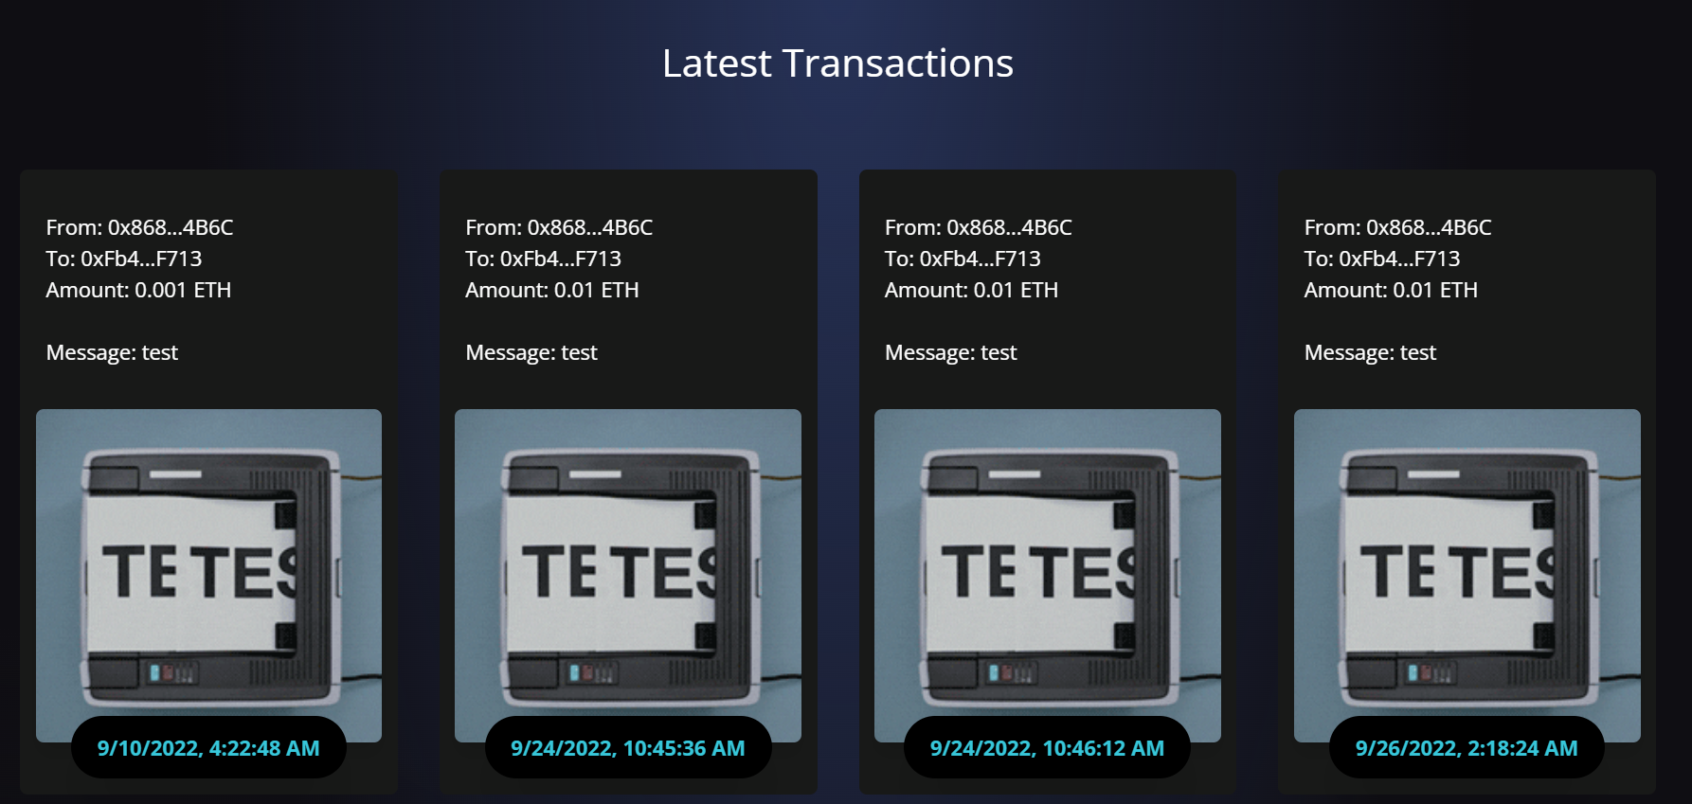
DISPLAY LATEST TRANSACTION

Slide 24
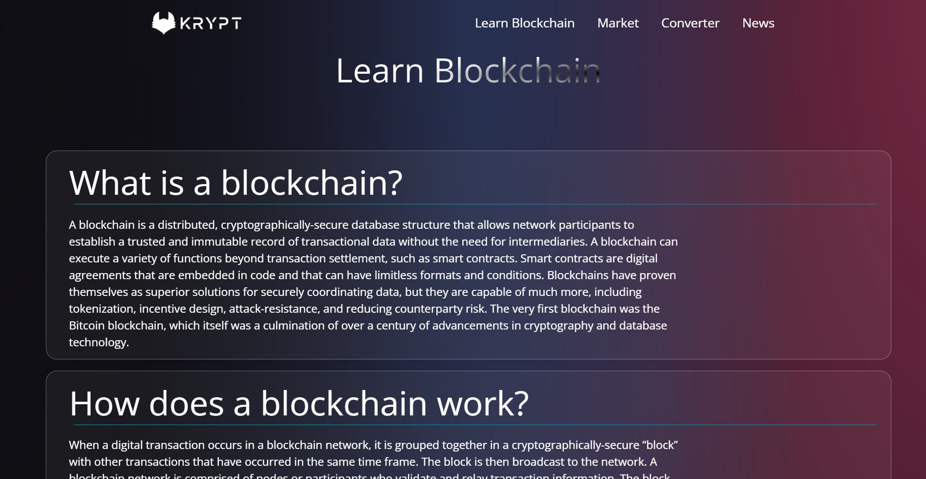
LEARN BLOCKCHAIN

Slide 25
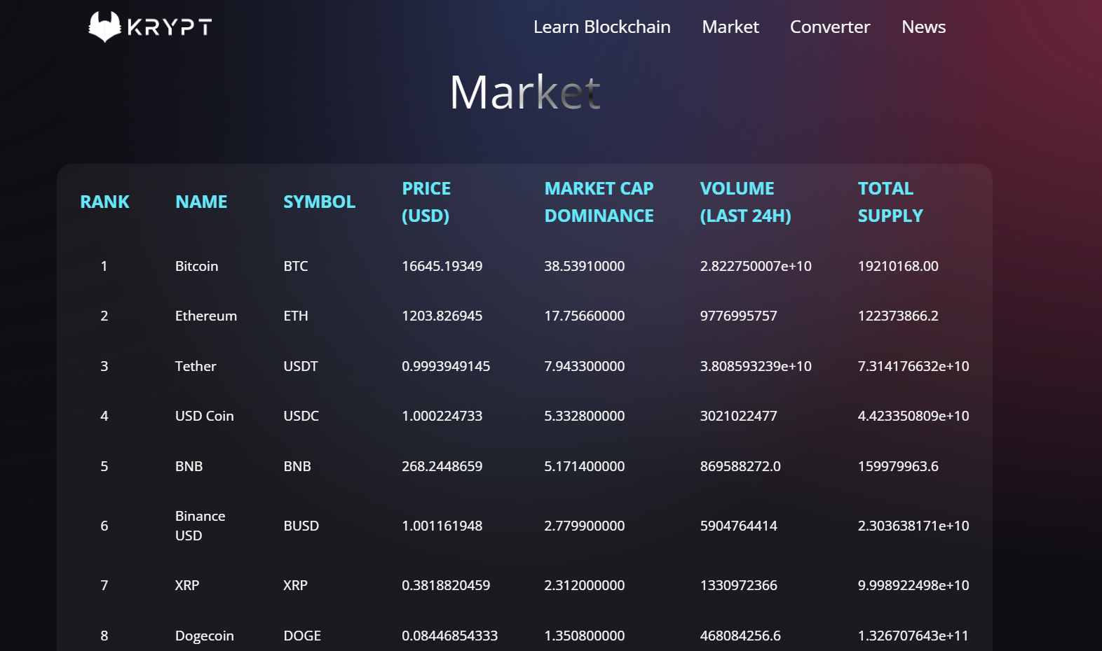
CURRENT MARKET

Slide 26
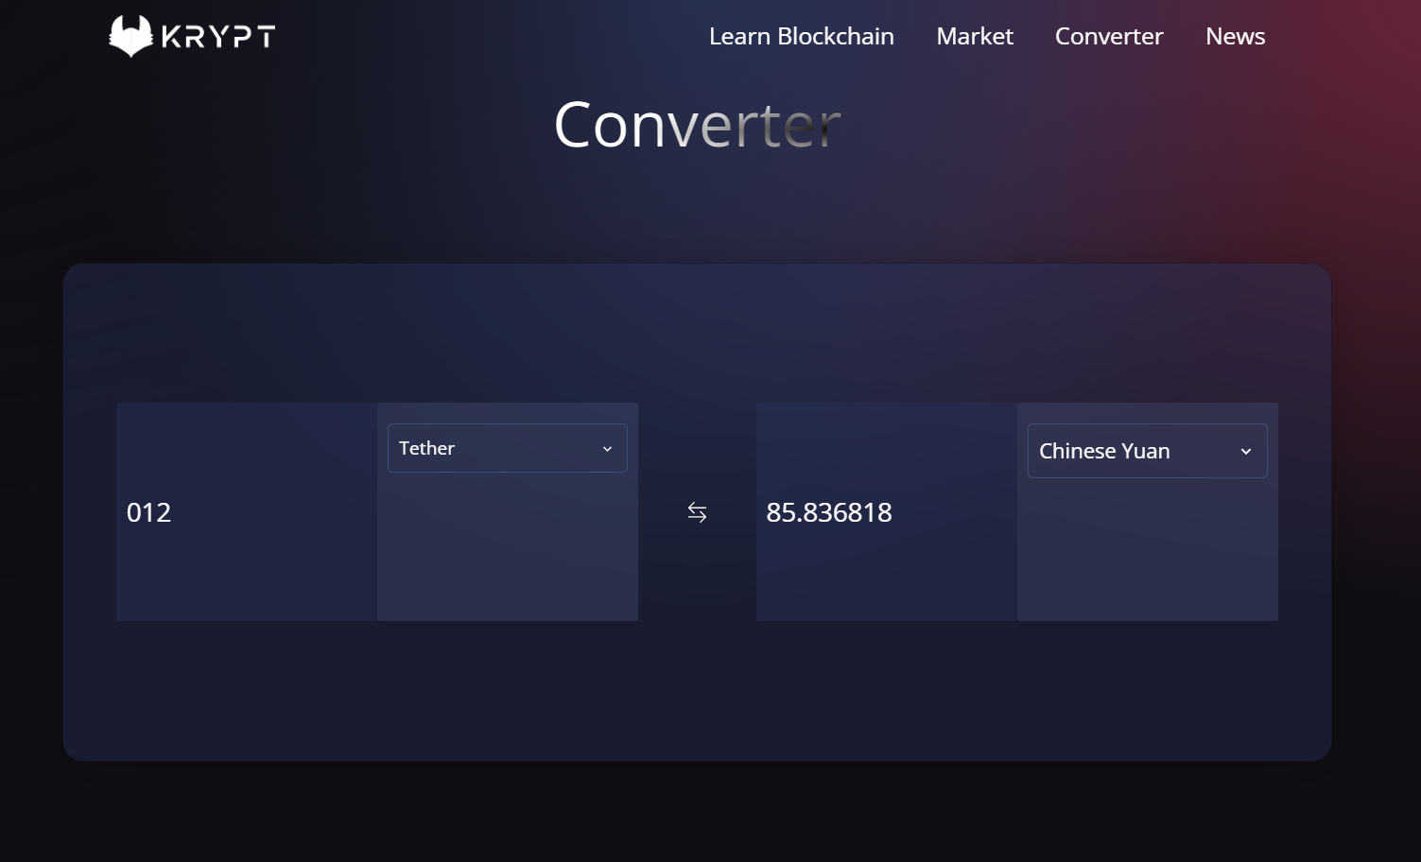
CRYPTO CONVERTOR

Slide 27
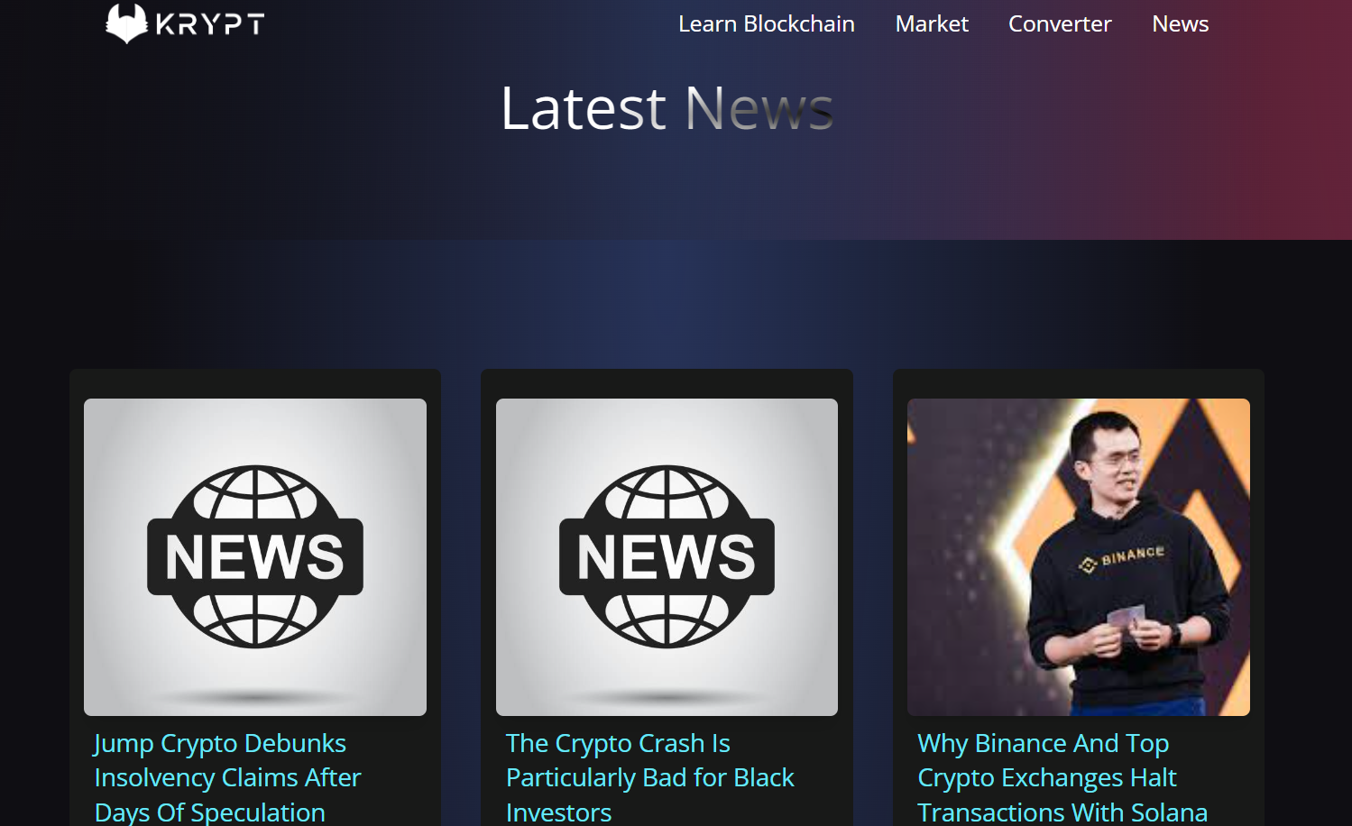
LATEST NEWS FOR CRYPTO

Slide 28
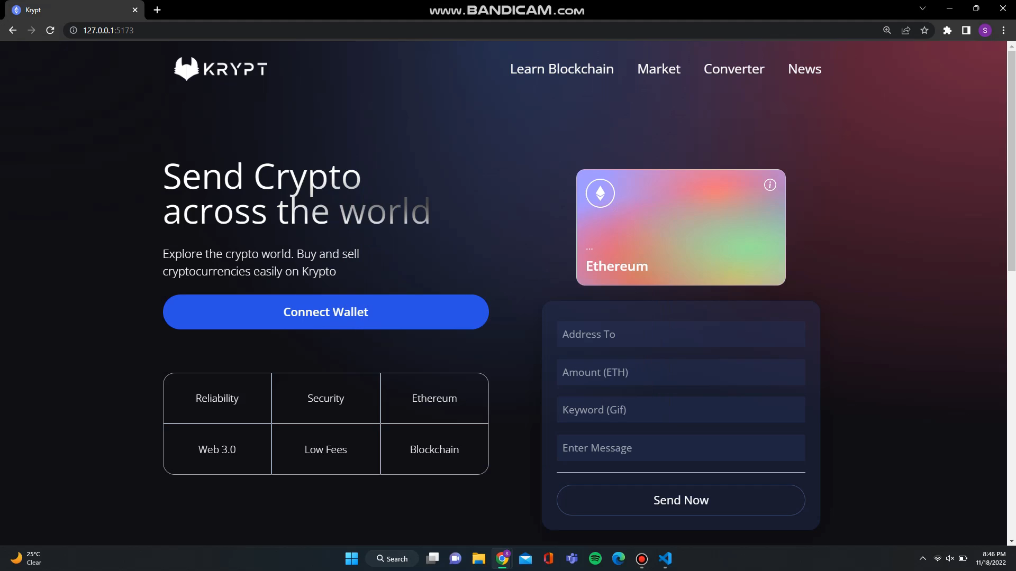
DEMONSTRATION…

Slide 29
THANK YOU

